Slide 1


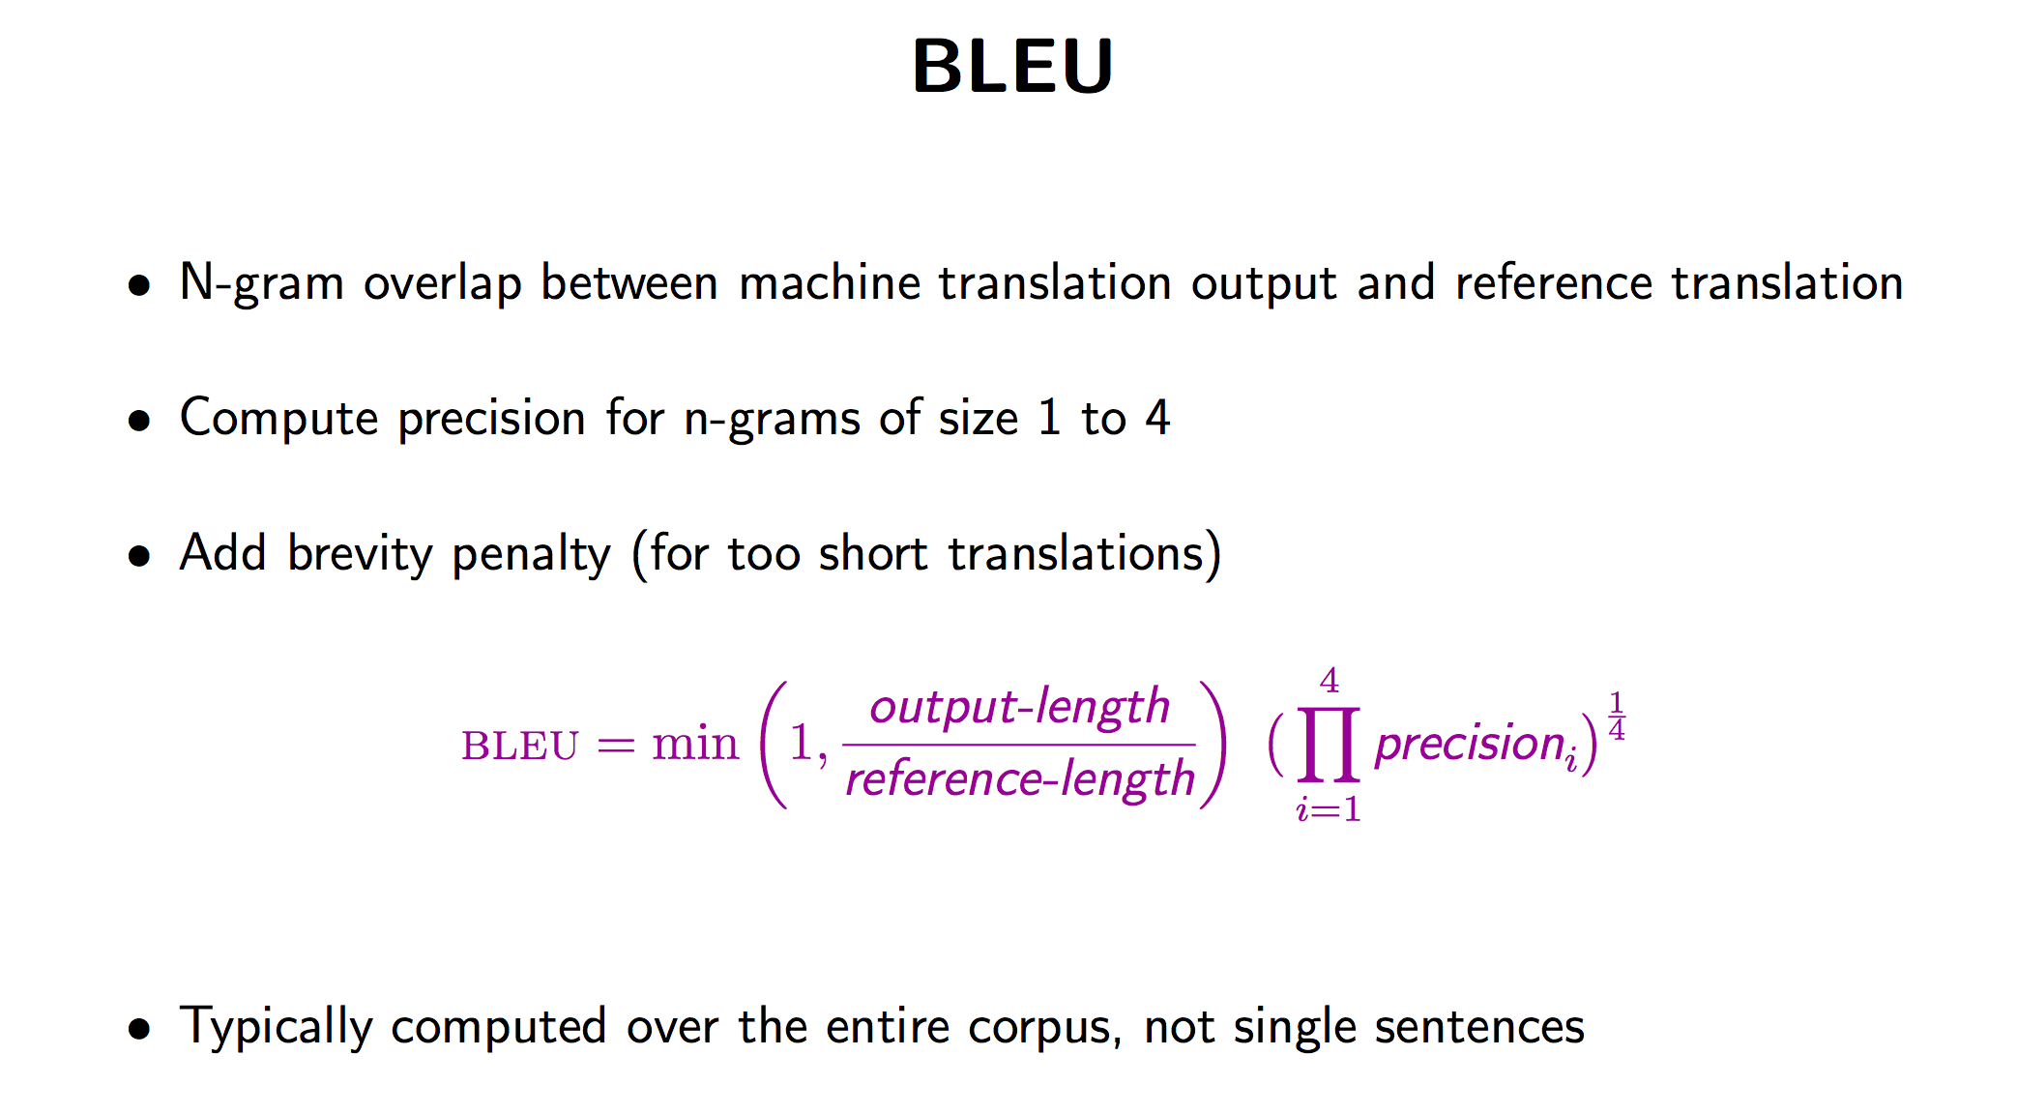
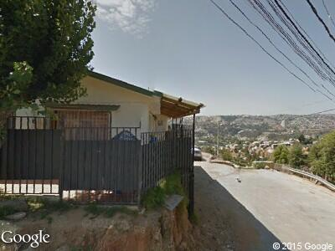

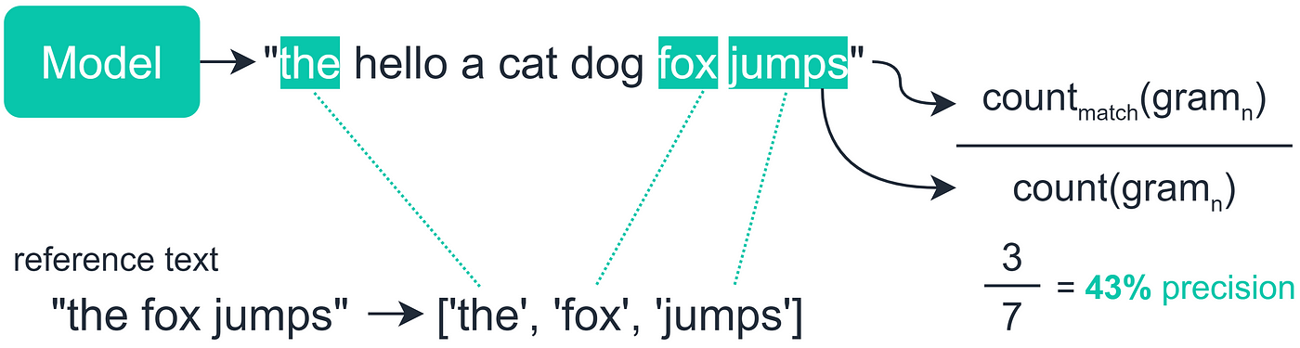
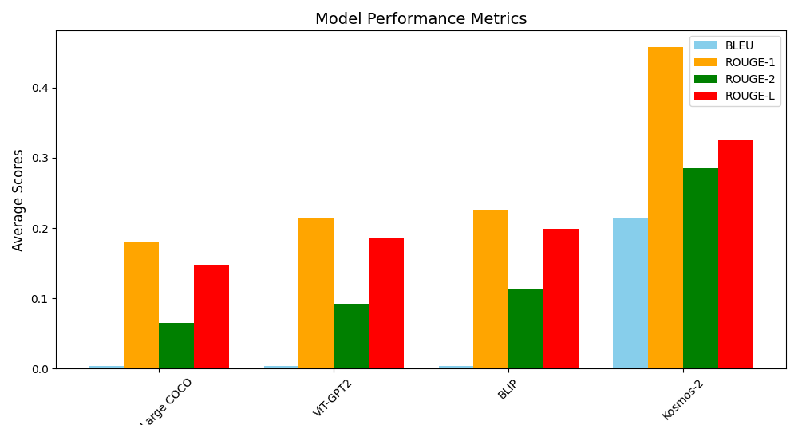
Exploring Scene Understanding with Large Language Models
Demir Bucukoglu, David Fernandez, Mert Pese
Which LLM is best suited for identifying objects in autonomous vehicles and what are the strengths and weaknesses of each model.
Different LLM’s were compared on their ability to describe and caption images.
Scores were primarily based on how similar the model caption was to a human-written caption (scores ranged between 0 to 1)
Kosmos-2
VIT-GPT2
BLIP
GIT Large COCO
Evaluate captions based on similarity
Run the LLM’s on the image
Compare to a Human caption
A small house situated on a hill overlooking a city. The house is surrounded by a fence and there is a car parked in front of it. The car is parked on the left side of the image and a person can be seen standing near the fence. There are also two birds in the scene.
A street with a fence in front of a house
Example
Analysis
Results
Git Large COCO:
the building where the guesthouse is located
BLEU: 0.0000
ROUGE-1: 0.0811
ROUGE-2: 0.0000
ROUGE-L: 0.0811
ViT-GPT2:
a house that has a fence around it
BLEU: 0.0001
ROUGE-1: 0.1333
ROUGE-2: 0.0274
ROUGE-L: 0.1333
BLIP:
a street with a fence in front of a house
BLEU: 0.0010
ROUGE-1: 0.2078
ROUGE-2: 0.0800
ROUGE-L: 0.1818
Kosmos-2
The image features a small house with a black metal fence surrounding it. The house is located on a hill, and there are mountains visible in the background. There are two cars parked in front of the house, one on the left side and the other on the right side. In addition to the cars, there are a few people scattered around the area, with some standing closer to the house and others further away. A few birds can be seen flying in the sky, adding a touch of natural beauty to the scene.
BLEU: 0.1752
ROUGE-1: 0.4911
ROUGE-2: 0.2342
ROUGE-L: 0.3036
BLUE and ROGUE-1 quantitatively compared how many words matched with the human captioning; if 1 out of 4 words matched, the score would be 0.25.
The LLM model Kosmos-2 had the highest BLEU and ROUGE scores. This was followed by BLIP and VIT-GPT2, which scored similarly to each other. GIT Large COCO came in last with the lowest scores.
Human Caption:
The image features a small house situated on a hill overlooking a city. The house is surrounded by a fence and there is a car parked in front of it. The car is parked on the left side of the image.
Model | BLEU | ROGUE-1 | ROGUE-2 | ROGUE-L
GIT Large COCO | 0.0036 | 0.1799 | 0.0649 | 0.1478
VIT-GPT2 | 0.0035 | 0.2137 | 0.0927 | 0.1861
BLIP | 0.0036 | 0.2259 | 0.1130 | 0.1986
Kosmos-2 | 0.2139 | 0.4581 | 0.2849 | 0.3247

